Slide 1
Twitter Sentimental Analysis
Akshaykumar Patil
Akshaykumar.patil002@gmail.com

Slide 2
Project Description
Daily Analysis of a product such as sentiments and Emotions using Twitter data.
Need to pull the data of a product from Twitter using API.
Data transformation/Text processing using Python.
Need to get product sentiments Analysis(positive, negative and neutral) and emotion analysis(happy, sad, angry, etc) on twitter data with some charts like pie-plot, Barplot and Worldcloud Visualisation.
Deployment through Flask/Heroku.

Slide 3
Tools Used/Requirements
Pyhton – Programming language to design Logic.
Tweepy - OpenSource Twitter API for Python.
Textblob - Python library using nltk to find polarity of text/tweet.
Flask – extensible web microframework for building web applications with Python.
Heroku - platform as a service (PaaS) to deploy the Module.

Slide 4
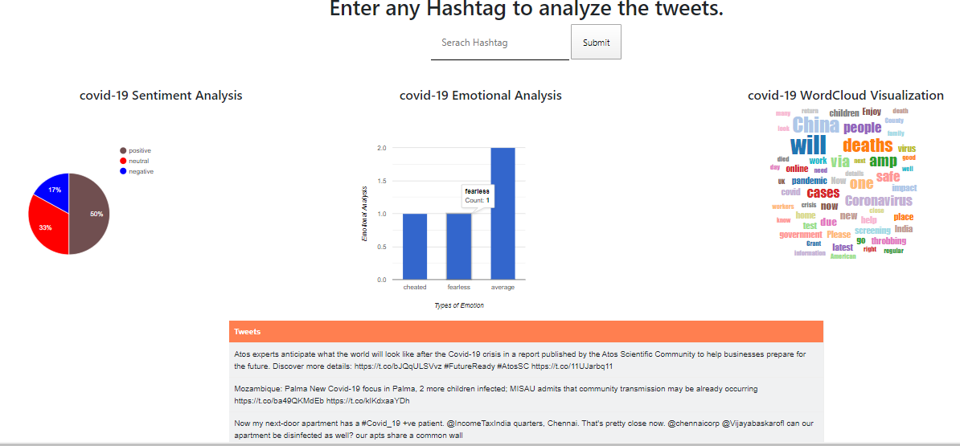
Heroku Deployment Live Demo: https://sentiment-analysys-twitter.herokuapp.com/

Slide 5
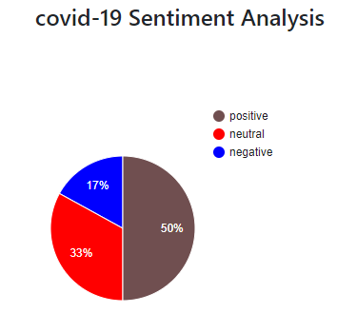
Sentiment analysis Visualisation
From the Sentiment analysis Pie chart representation we could say that for the tweets for covid-19 hash tag search
50% of tweets are Positive .
17% of tweets are Negative .
33% of tweets are Neutral.
By looking at the numbers our Inference is,
Due to COIVD-19 Pandemic, billions of people across the world are under lockdown, factories are shut across the world, which has significantly decreased the pollution, and nature reclaiming it’s position. Which can be confidently classified under Positive sentiment.
Also COIVD-19 caused illness to millions of people, thousands of death ,and have caused recession or Economic downturn across the several nations which have caused huge unemployment. is broadly classified under Negative sentiment .

Slide 6
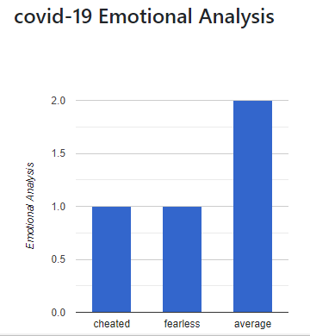
Emotional analysis
From the Emotional analysis bar chart Visualization we could say that
Majority of the information are rigorously classified under “SAD” emotional value since COVID-19 has caused illness, deaths around the world. Which it turn caused huge unemployment.
Minority of information are classified under “POWERLESS” since few First-World countries or Developed nation such as USA, UK, Italy, German, etc suffered the most from the pandemic even being a highly developed nation.
Few information are classified under “ANGRY” since COVID-19 might has caused unemployment which have enraged millions of people.

Slide 7
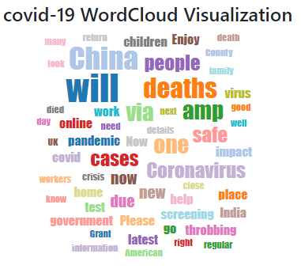
Word Cloud representation on Covid-19
From the Word Cloud visualization we could say that Keywords Like
India , Caronavirus, Deaths, virus, pandemic, government American, cases
are most talked information or topic based on our Twitter data analysis.

Slide 8
Thank You.

